Slide 1
Presentation to the
Brain Injury Association of Virginia
Aphasia:
What is it and How to Deal with the Challenges
Presented by
The RVA Aphasia Group
January 11, 2023

Slide 2
Participants from RVA Aphasia Group
Speech/Language Pathologists and a Survivor
Susan B. Hapala, M.Ed., CCC-SLP
Fern S. Cohen, M.Ed., CCC-SLP
Risa F. Levine, M.S., CCC-SLP
Deborah Seitz, TIA Survivor

Slide 3
Introduction
Why are we here today? And, just what is the RVA Aphasia Group?
We are here today to talk about what aphasia is, what causes aphasia, and common misconceptions about aphasia. We will also give you tips on how to communicate with a person who has aphasia.
RVA Aphasia Group consists of SLPs and stroke or TIA survivors and their families. We strive to present a friendly and welcoming atmosphere where people with aphasia can relax and build relationships with their peers while practicing their speech.

Slide 4
Definition of Aphasia
Aphasia is a language disorder that affects the ability to communicate
Usually damage to a part of the left side of the brain causes aphasia
Aphasia is most often caused by stroke
People may have trouble with understanding what people say to them and difficulty with expressing their thoughts

Slide 5
Definition (continued)
Word finding problems are characteristic of aphasia
Some people with aphasia may not be aware of their communication deficits, especially if they are not understanding
Signs and symptoms of speech may vary among individual people with aphasia
Severity of symptoms may vary
People with aphasia may also have difficulty with reading, writing and/or math

Slide 6
Statistics
Approximately 2 million people are estimated to have aphasia in the United States (National Aphasia Association)
Approximately 1/3 of strokes result in aphasia
80,000 new cases of aphasia each year in the U.S. (National Stroke Association)
15% of individuals under the age of 65 experience aphasia (ASHA)
43% of individuals 85 and over experience aphasia (ASHA)

Slide 7
Importance of Speech Therapy and Evaluation
Early evaluation and speech therapy treatment for aphasia by speech pathologists is recommended for all types of Aphasia.

Slide 8
Causes of Aphasia
Stroke
Traumatic Brain Injury (TBI), (for example, gunshot wounds, blast injuries, blows to the head)
Brain Tumors
Brain Surgery
Brain Infections
Other neurological diseases which are progressive in nature, (for example, Alzheimer's, Parkinson’s, Primary Progressive Aphasia or combinations of multiple problems)

Slide 9
Causes (continued)
Temporary causes of aphasia, for example
  Migraines
  Seizures
  TIAs (mini-strokes)
  Medications

Slide 10
Common Misconceptions about Aphasia
People with aphasia are NOT:
Under the influence of drugs or alcohol
Subject to intellectual disability
Psychologically ill
Unwilling to try

Slide 11
Common Misconceptions (continued)
People with aphasia are NOT:
Demented
Always elderly
Always physically impaired
Static in their ability to improve language function after 6 months of onset

Slide 12
Communicating with Persons who have Aphasia
To Improve Person’s Understanding of Speech:
Get their attention before beginning
Address them directly
Address them in short sentences
Repeat/rephrase when necessary
Keep your voice level normal and emphasize key words
Talk slowly
Augment by using gestures and visual aids
Turn off competing sounds

Slide 13
Communicating (continued)
To Help the Person Get the Message Out:
Ask one thing at a time; then wait for them to speak
Avoid finishing their sentences-unless you have permission
Make sure there is clear way to respond to yes/no questions, for example, thumbs up/down
Ask fixed question (not open-ended questions)
Ask person to give a clue by gesturing, pointing or drawing
Be careful with numbers, days of week – they often have trouble with them; also yes/no or left/right, so verify the information

Slide 14
Communications Toolkit
Alphabet board
Argumentative Devices
Texting on a phone, iPad, or other electronic device
Pencils and paper or magic slate for writing or drawing
Simple picture chart
Hand gestures
Communication tips

Slide 15
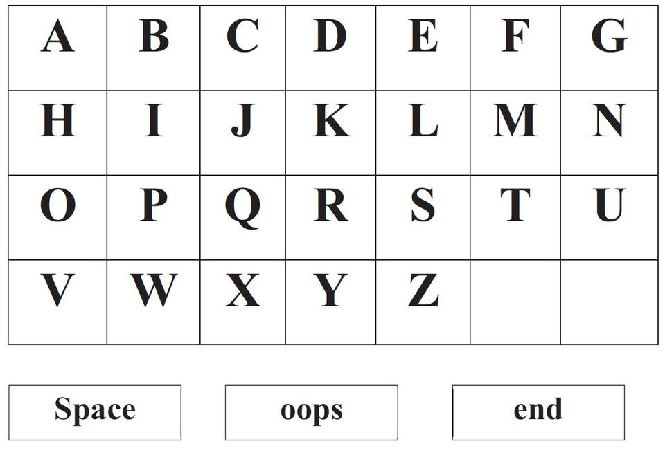
Alphabet Board

Slide 16
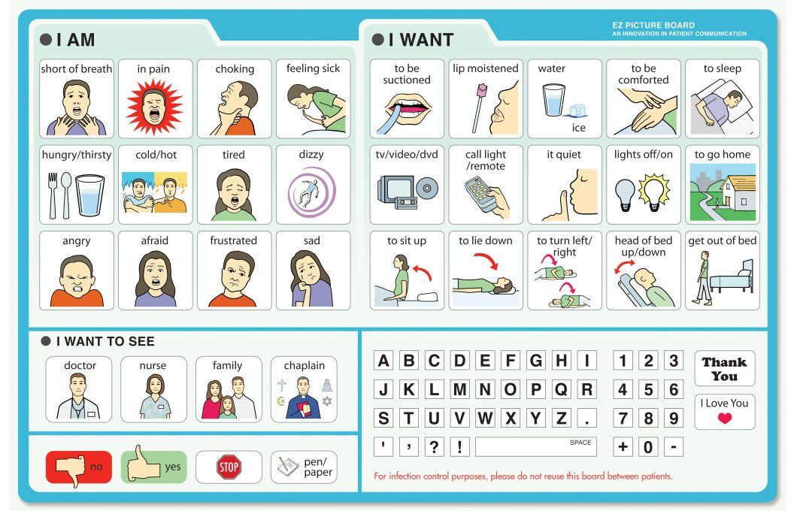
Picture Chart

Slide 17
Summation
Aphasia-friendly communication can be summed up with this acrostic for the word aphasia:
A: ask simple, direct questions
P: provide multiple communication options
H: help communicate if asked
A: acknowledge frustration
S: speak slowly and clearly
I: if you don’t understand, say so
A: allow extra time

Slide 18
RVA Aphasia Group Resources
Our video: “Patience, Listening and Communicating with Aphasia Patients”
www.rva-aphasia.com
Facebook – Living with Aphasia
Email – info@rva-aphasia.com

Slide 19
The RVA Aphasia Group
Thanks you for your time and your interest.
We will now answer your questions.
Speech/Language Pathologists
Fern S. Cohen, M.Ed., CCC-SLP
Susan B. Hapala, M.Ed., CCC-SLP
Risa F. Levine, M.S., CCC-SLP
Deborah Seitz, TIA Survivor

